Slide 1
Tagged as “go” &
Don’t contain “go”
Detectable
Have word “go”
(Non Detectable)
650
1208
1696
(1858-1208)

Slide 2
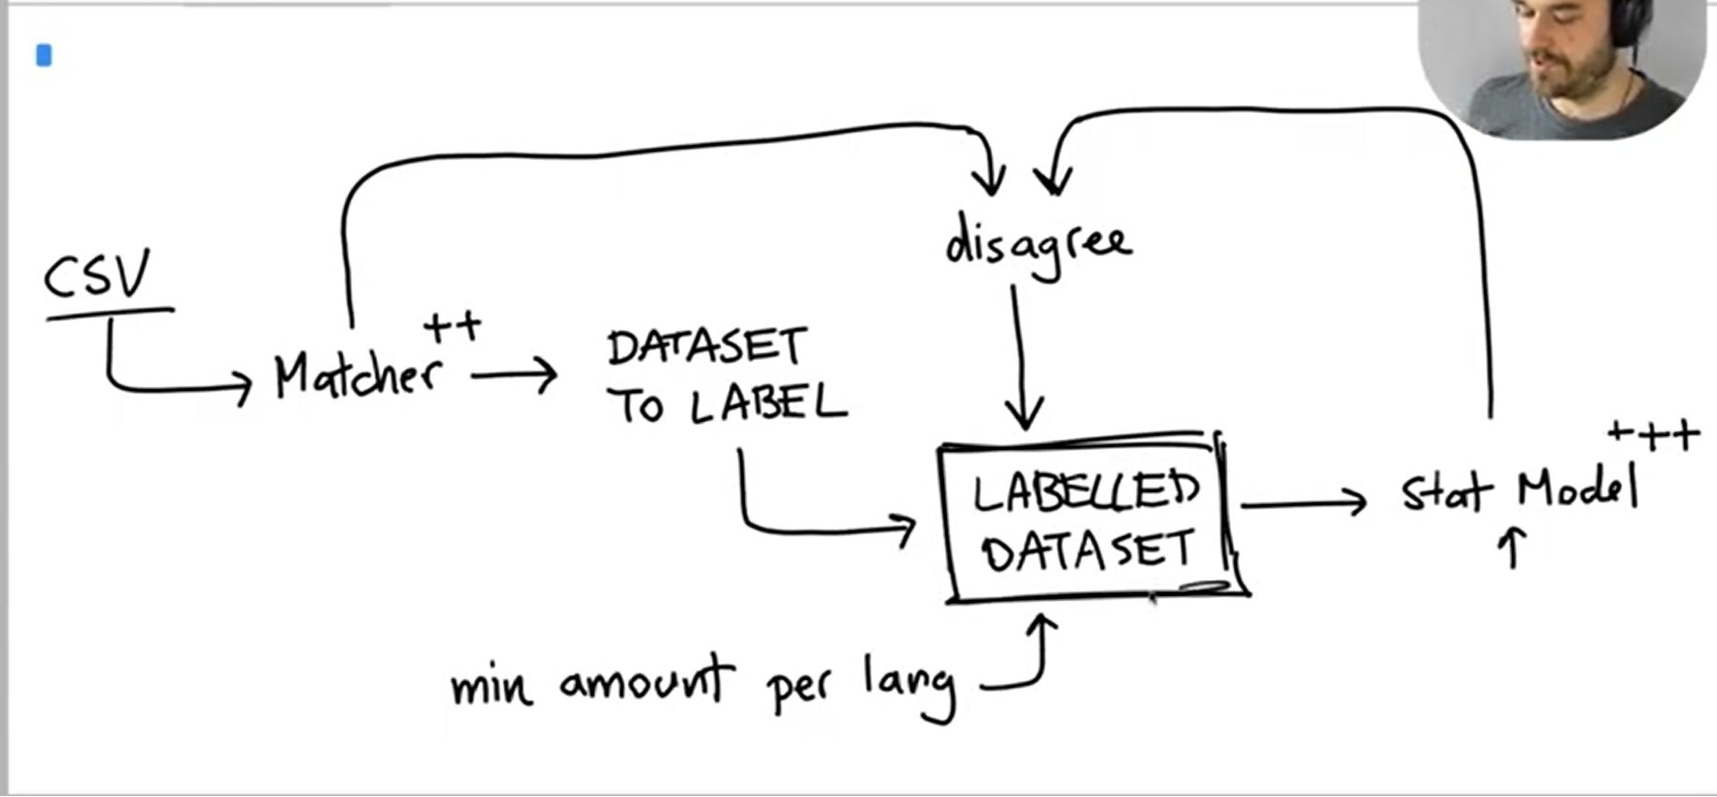
To improve our model, we must see where our ML model and Matcher model conflicts. We can improve both Matcher and ML model from this process
This can be done using Prodigy as well
Using Manual Matching to a subset to generate labels
Using Rule Matching to generate labels
Improve Matcher Rules using manual results (see conflicts)
Using the 500 manual matches, we can build a ML model by updating the NER process in the pipeline and creating our own custom entity
If we choose the first 500 manual matches: there could 400 out of them with Python label. This creates an underfit for the other languages and gives us bad results for other languages and inflated accuracy because of python

